Slide 1
Git Introduction
I should get pay teaching you guy.

Slide 2
What is “Version Control Tools”?
Version Control Tools are way to records changes to a file or set of files so that you could keep track of changes. It allows you to use the reverse engineering option to selected files back to precious state, keep track of changes for you to compare over time, see who last modified something that might causing you problem so that you could avoid killing the wrong person and more.
Short version: The excuse “My dog/cat deleted my homework” or “My dog/cat ate my computer” will no longer work. You could now try to be this guy. Think again if you are using Centralized or Distributed Version control Systems.

Slide 3
3 types of VCS:
Local Version Control System.
Centralized Version Control System.
Distributed Version Control System.

Slide 4
Local Version Control Systems:
This method is similar to you copy files into another directory as backup copy (or if they’re clever, they would copy into a time-stamped directory).
However, it is not a life happen bullet prove. Sometime you could forgot and write into the wrong directory or copy the old file to the directory which means you lost everything.
Being nerdy, computer nerds deal with this issue by developed local VCSs that had simple database that kept all the changes to files under revision control. You generally mostly add to the version database from your working directory and copy from it but you don’t (or not really) have access to that database to prevent lost of information. (It doesn’t mean you cannot. Just as long as you don’t try it, you’ll be fine.

Slide 5


Slide 6
Centralized Version Control Systems:
This method was created to solve the problem when developers encounter while collaborate with each other. They need a way to share information between each other so Centralized Version Control Systems (CVCSs) were developed.
This method use a server to host the version database that everyone who are in the project could access it anytime. (Until the server got is down of course and that is the problem)

Slide 7
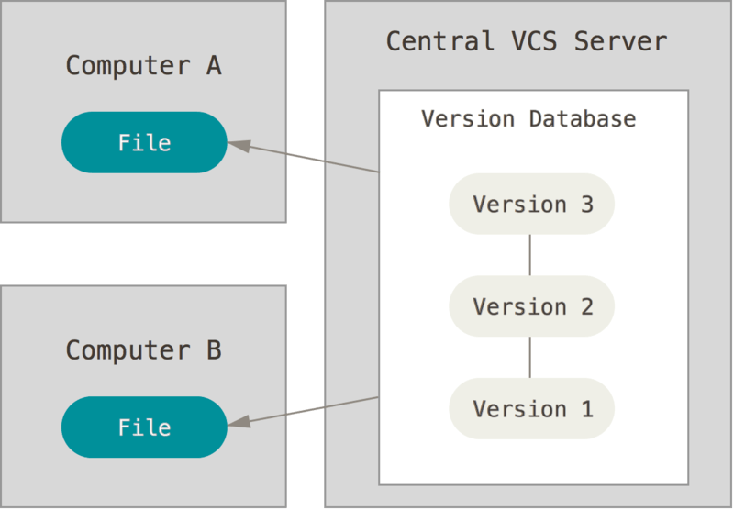

Slide 8
Distributed Version Control Systems:
Distributed Version Control System takes it to the next level. To prevent situation when the server is down and life happen, every member have a copy of the project in their local database. This give you an advantage of able to work offline too.
This is like exactly like having a Local Version Control that connect to the Centralized Version Control.

Slide 9
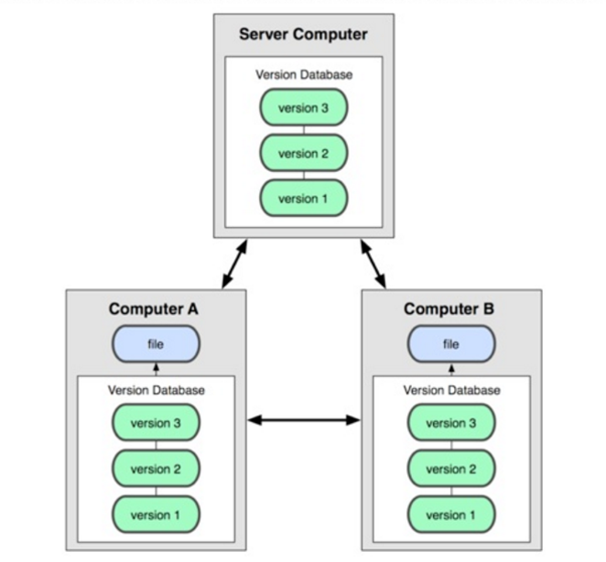

Slide 10
Quick introduction of how Git storing data.
Git does not store based on changes, it store as snapshots. Every time you commit (Save the state) of your project, Git basically take a snapshot of the file you commit (You need to have something change to commit, it would not let you just spam commit for fun. Nice try, even if you make some changes and just return to the original state and commit, Git will recognize it and does not store the file again).

Slide 11
Note:
Most of your operation is local. It is prefer you upload files that are done or they are working and not files that you are still working on. This is prefer because the central serve is where all the good copies are at.
Stuff that you are working and you want to save should only be save at your local database and not sending around to other people.

Slide 12
The Three States: (VERY IMPORTANT)
Git has three main states and those are: committed, modified, and staged.
Committed: The data is safely stored in your local database.
Modified: You had make changes the file but have not yet commit to your database.
Staged: You have marked a modified file (file that you had make changes) in your working directory to go commit and change it in the local database. (This stores information about what will go into your next commit. Could also be refer as “Index”.

Slide 13
The Basic of Git workflow:
Modify files in your working tree (Working directory). This means you make changes to files in your working tree.
Selectively stage the changes (modified files) you want to be part o your next commit. You select the file you want to be in your next commit not individual changes.
Commit, which takes the files you’ve selected in staging are and stores it as snapshot permanently to your Git directory. Only commit files that you done with and not in middle of working so that you could go back to the last committed version if wish. If you think the code you are currently working could be useful for the future or wish to keep it for any reason but need to return the last committed version, put it in the recycle bin text file.
It is possible to skip the staged process entirely if wish.

Slide 14
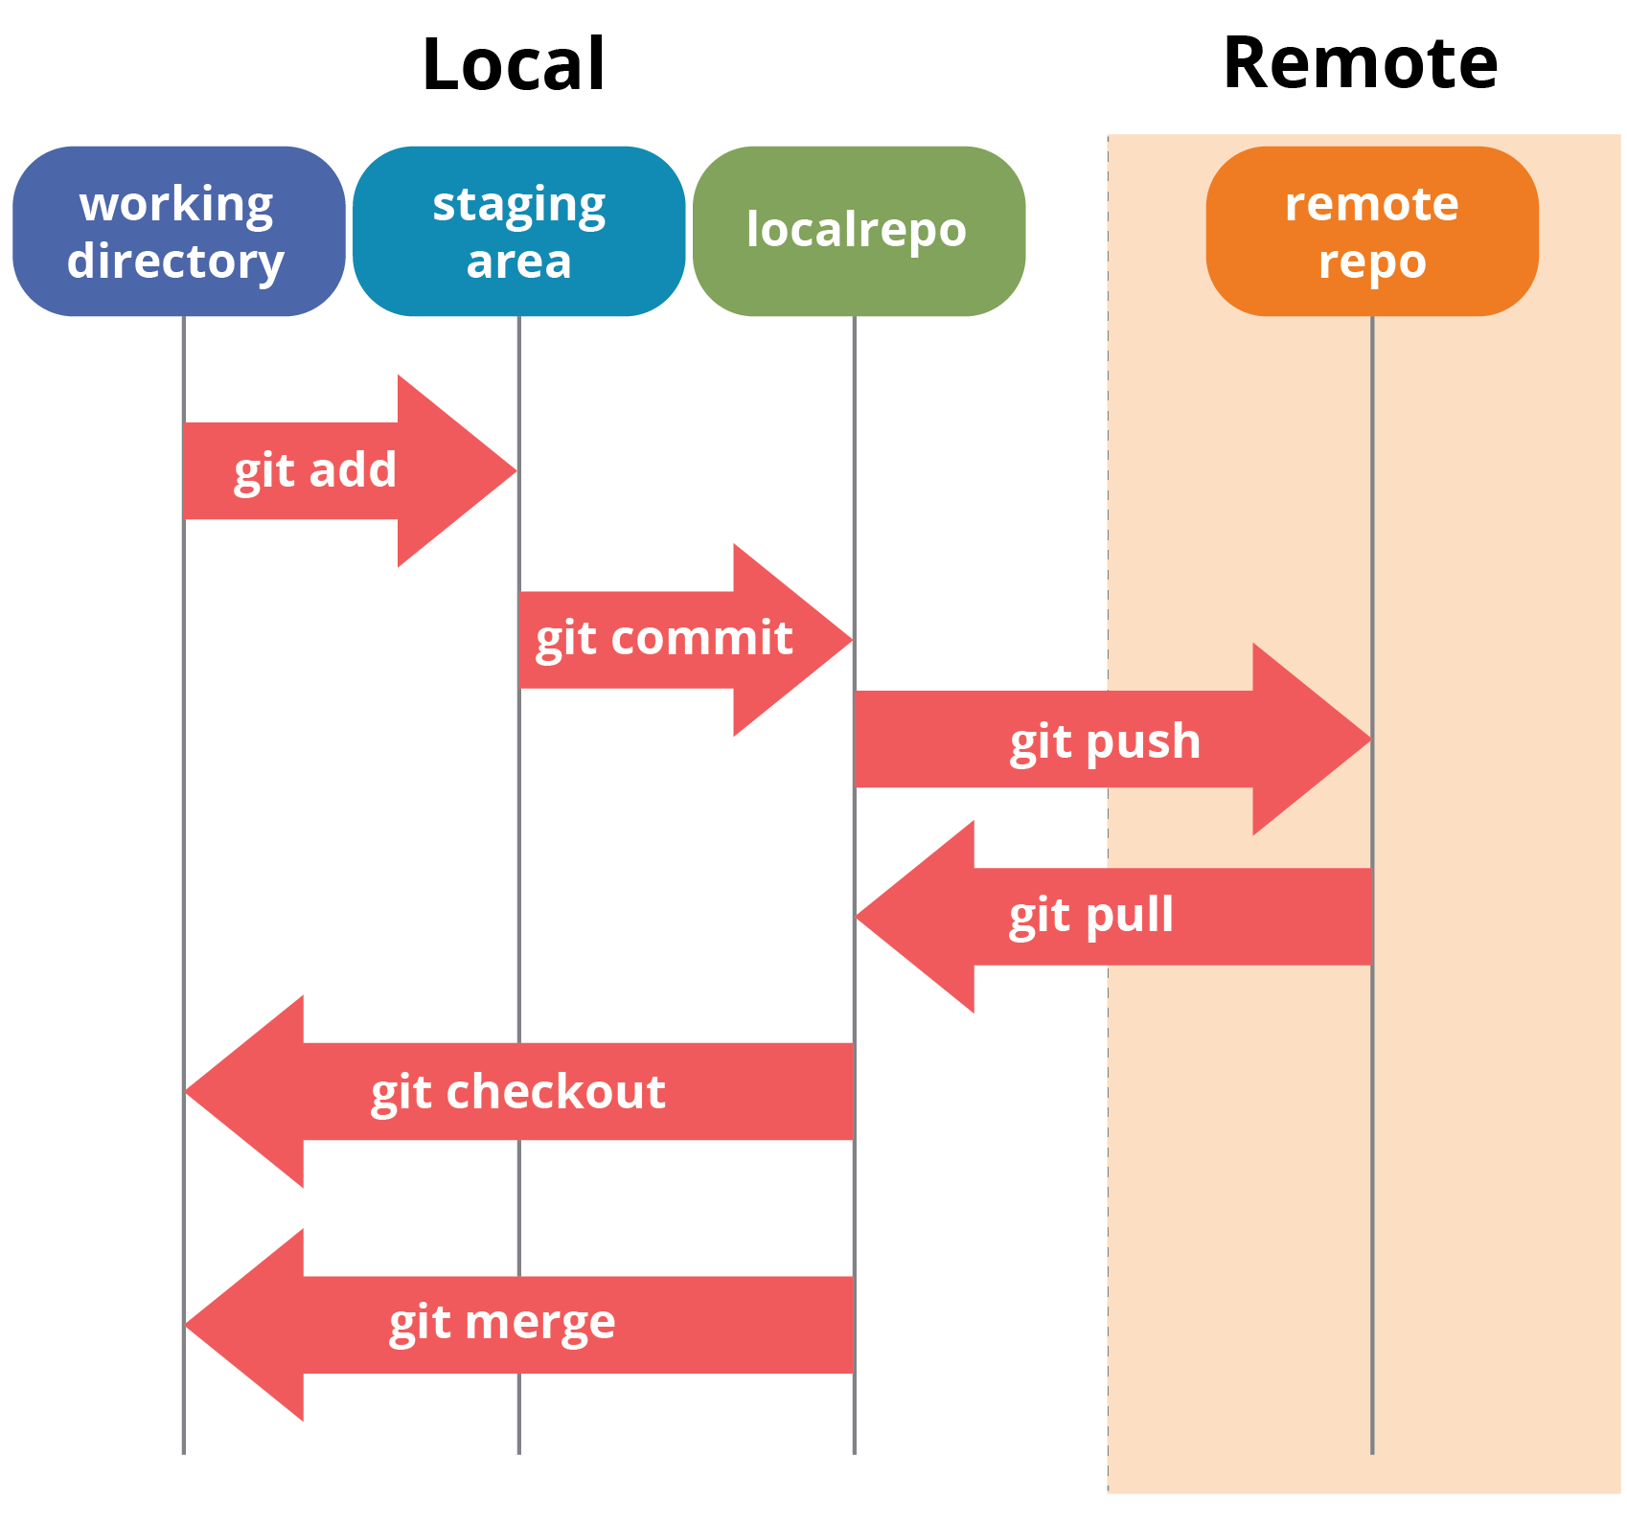

Slide 15
Using Git:
In this lesson, we are going to focus on using Git on command line. Command line is a TBI means text-based interface. There is GUI means graphical user interface version out there; however, that level is too low for nerdy people like us. We going to use specifically bash command line but just to let you know that you could also use command prompt.
But for real, take a look at the graphic user interface Git, it just trash.
Good side, if you know how to use TBI you could safely say it would be easy transit to GUI while the opposite is not necessarily true.

Slide 16
Installation:
Linux:
Fedora or closely-related RPM-based distribution:
$ sudo dnf install git-all
Debian-based distribution:
$ sudo apt install git-all
Mac:
$ git --version
Windows: Ya… just going to their website and install it… nothing special and I am so sorry. We all know Windows is boring.
https://git-scm.com/download/win

Slide 17
First-Time Setup Git: Customize Git Environment
These things should only require you to setup the first time after install and they could be change any time by simply running through the commands again.

Slide 18
git config
It lets you set configuration variables that control all aspects of how Git looks and operates.
These variable can be stored in three different places:
/etc/gitconfig file: Contains values applied to every user on the system and all their repositories. If you pass the option --system to git config, it reads and write from this fil specifically. (Because this is a system configuration file, you will need administrative or superuser privilege to make changes to it)
~/.gitconfig or ~/.config/git/config file: Contains values specific to you, the user. You can make Git read and write to this file specifically by passing the --global option. This will affects all of the repositories you work with on your system.
config file in the Git directory (that is .git/config) of whatever repository you’re currently using Specific to that single repository. You can force Git to read from and write to this file with the --local option, but that is in fact the default option.
Each level override values of the precious level. This mean that Local, Global, then System. Local have the upper hand just like when you code.

Slide 19
Set up your identity:
The first thing you should do after install Git is to set your username and email address. You should set it because every time you use commit, it use this information too keep track of who is making changes.
$ git config --global user.name “USERNAME_HERE”
$ git config --global user.email “EMAIL_HERE”
You would only have to do it once if you pass as global option. You could override using local.

Slide 20
Set up text editor:
You can configure the default text editor for Git. If this was not set up, Git will automatically use your system’s default editor.
$ git config --global core.editor TEXT_EDITOR_NAME
For Windows System, you must specifically location path to its executable file.
$ git config --global core.editor “C:/ProgramFiles/Notepad++/notepad++.exe”

Slide 21
Check your setting:
$ git config --list
You may see keys more than once. This happen because there are same keys from different files for system, global, and local.
$ git config ENTER_KEY_HERE
You can also search for specific key.

Slide 22
Kid Help Line:
We will probably only use “-h” or “--help”. This will give you a quick guide on available options for Git command and format. For more help, use other options that I will not be discuss because I am a lazy person. Help yourself.

Slide 23
Summary on First Time Set Up Git:
You should be able to know the basic of what is Vision Control Systems.
A working version of Git.
Set up your personal identity.
Able to access kid help line.

Slide 24
Git Basic: After this you could basically perform most of the task you need to do.
Repository = Directory but also Repository ≠ Directory. Same shit different pile but the only problem is one of them is on steroid.
A directory is also known as folder and it is use to help organize files the computer file system while repository is the same as directory but with extra ability of recording changes made within that folder by adding some kind of information and data recording layers to collect and keep a log of changes that had been make.
Under the directory/folder we are trying to record, there will be a sub-folder called “.git”. This folder have the same structure as any other folder but it was made with the job of recording changes and keep a history of parent folder.

Slide 25
Two ways to make a Git Repository:
Take a local directory that is not under version control and turn it into repository by add in “.git” file to record changes, this process is called “Initializing”.
Clone an existing Git repository.

Slide 26
Initializing a Repository in an Existing Directory:
Locate the folder path using the command-line interpreter.
Type the next command: “$ git init”.
This “init” command will creates a new subdirectory name “.git” that contains all of the files that are necessary to record the history of the chosen directory, this also refer as “repository skeleton”.

Slide 27
Cloning an Existing Repository:
Find the URL of the repository you are trying to clone.
Type the next command: $ git clone URL_HERE
When you clone a repository, there is already a “.git” sub-folder in it.

Slide 28
Recording Changes in the Repository:
Files in working directory can be in one of two states: tracked or untracked.
Tracked files are files that were in the last commit/snapshot and they can be files that unmodified, modified, or staged.
Untracked files are files that were delete or new files you’ve just created.
Basically, tracked files are files that Git recognize and have a record of while untracked files are new files or those that you’ve removed which mean Git no longer track them.

Slide 29
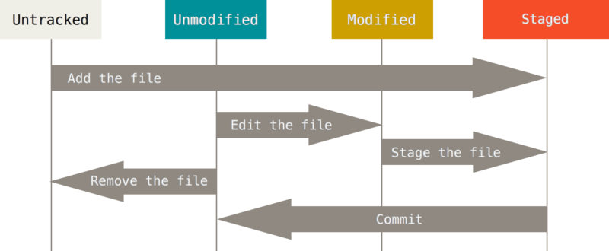

Slide 30
Checking status of your files:
Status: The current state of someone or something. In this case, we are refer to the files in our repository.
You could check the status of your files using the command:
$ git status
This will shows you all the tracked and untracked files. Files that occur in red are new untracked or changed files. If you add it into staging area, it will turn green and that means those files are ready to commit and save change.

Slide 31
Short Status:
By adding “-s” or “--short” prefix, you get far more simplified output.
$ git status –s
or
$ git status --short
Output:
?? -> New files that are not tracked.
A -> New files that have been added to the staging area. (New tracked)
M -> Modified files. (Files that have new changes)
MM -> Modified and staged but then modified again.

Slide 32
Ignoring Files:
If there are files you don’t want Git to keep track or show you that file is untracked, you could create a list of things you want Git to ignore. The file Git read to know what items you want to ignore is called “.gitignore”. Create a file and name it “.gitignore”.
$ cat .gitignore

Slide 33
Rules in the .gitignore File:
Blank line or like start with # are ignored.
You can use glob patterns and it will be applied recursively/repeatedly throughout the entire working tree.
Start patterns with a forward slash “/” to avoid recursive.
End patterns with a forward slash “/” to specify a directory.
Negate a pattern by starting it with an exclamation point “!”. (Comment it out is also work)
It is possible to have additional .gitignore file in subdirectories.

Slide 34
Write in .gitignore file sample: https://github.com/github/gitignore
# ignore all .a files
*.a
# but do track lib.a, even though you're ignoring .a files above
!lib.a
# only ignore the TODO file in the current directory, not subdir/TODO
/TODO
# ignore all files in the build/ directory
build/
# ignore doc/notes.txt, but not doc/server/arch.txt
doc/*.txt
# ignore all .pdf files in the doc/ directory and any of its subdirectories
doc/**/*.pdf

Slide 35
Clean Working Directory:
If you run the command “status” and this occur:
$ git status
On branch master
Your branch is up-to-date with ‘origin/master’.
nothing to commit, working directory clean
This means all of your files are save and there is no changes made. (You did not create a files or none of your tracked files are modified/change)

Slide 36
Tracking New Files:
If you’ve just added in a new file and want to track it, you could add it to staging area.
$ git add FILE_NAME
Staging Modified Files:
First you have to add the file to staging area like tracking the new file.
Then use commit to record the history of those files.
The “add” is a multipurpose command. You use it to begin to track files, stage files for commit, or marking merge-conflicted files as resolved. In This case, it means “add this content to the next commit”.

Slide 37
Make change to a file after use add command:
When you use “add” command and decide to make some changes, it will result in that file listed as both staged and un-staged.
This happen because the “add” command stages the file exactly as it is when you run the command.

Slide 38
View your Staged and Un-staged Changes:
Use command “git diff” without argument. Research for yourself if you want to know more about it.
Use command “git diff --staged” to see what you’ve staffed that will go into next commit.
There are more options you can use but since this will less likely be use and I am too lazy, teach yourself if you want to know more.

Slide 39
Committing Your Changes:
Take a snapshot of what you choose you save in staged area.
Every time you perform a commit, you’re recording a snapshot of your project that you can revert or compare to later.

Slide 40
Skipping the Staging Area:
By adding the option “-a” to “git commit” command, Git will automatically stage every file that is already in tracked list letting you skip staging process.

Slide 41
Removing Files:
You could remove files using “rm” command or it would just be the same as delete normally but then you need to commit the change later.
You could do both of that steps in one command using “git rm FILE_NAME”.
If you don’t want Git to track a file which you should have add in .gitignore, you could use the “--cached” option.
$ git rm --cached FILE_NAME

Slide 42
Moving Files:
Git does not explicitly track file movement. Git would not know if you renamed the file because it does not keep track of this kind of stuff.
You could use the “mv” command to rename file.
$ git mv FILE_FROM FILE_TO
FILE_TO is the name you want to rename the file.
Instead of 3 lines of command:
$ mv README.md README
$ git rm README.md
$ git add README

Slide 43
Viewing Commit History:
To check the Git change log, you can use the log command.
$ git log
You can add “-NUMBER” to limit the number of entries.
$ git log -NUMBER
$ git log -2 <- Limit to 2 entries.

Slide 44
Reverse Engineer for a File:
To reverse a file back to the time it is last committed use “checkout”:
$ git checkout – <FILE_NAME>
If you look closely when using “git status” command, you will see it.

Slide 45
Working with Remote repositories:
Remote repositories are versions of your project that are hosted on the internet.
To check which remote servers you have configured (arrange or prepare so that it can be used), use the command:
$ git remote
It lists the short-names for the server URL you’ve specified. “Origin” is the default name Git gives to the server you cloned from.
You can add “-v” (verbose) to show the URLs that Git has stored for the short-name to be used.

Slide 46
Adding Remote Repositories:
Run:
$ git remote add <short-name> <URL>
After the add, every time you refer to short-name, it is the URL.

Slide 47
Renaming Remote:
$ git remote rename <CURRENT_NAME> <NEW_NAME>

Slide 48
Removing Remote:
$ git remote remove <REMOTE_NAME>
or
$ git remote rm <REMOTE_NAME>
All remote-tracking branches and configuration settings associated with that remote are also deleted.

Slide 49
Inspecting a Remote:
If you want to know more information about a particular remote:
$ git remote show <remote>

Slide 50
Get Data From The Remote Server:
Get all the new data that you don’t have from the remote project.
$ git fetch <remote>
It only downloads the data to your local repository, it does not merge the data with your current work so you would have to merge it manually to your work when you’re ready.
Automatically fetch and merge remote branch to your current branch.
$ git pull <remote>

Slide 51
Send Data To The Remote Server:
When you have your project at a point you want to share, prefer that it is not on working state. You can use “push” command:
$ git push <remote> <branch>
Your push will get reject if somebody in your team also try to push data to the server at the same time. You would have to fetch their work and merge into your before you’ll be allowed to push.

Slide 52
Tagging:
Git, like most VCSs, has the ability to tag specific points in data history as being important. People use this to typically mark release points or historic restore points.

Slide 53
List the Tags:
$ git tag (with optional -l or --list)
This will list in alphabetical order which means the way they appear has no real importance.
You can search for tags that match a particular pattern.
$ git tag –l “PATTERN”
You could see a specific tag you know:
$ git show <TAG_NAME>

Slide 54
Creating Tags:
There are two types of tags:
Lightweight.
Annotated.
Lightweight tag is very much like a branch that doesn’t change, it is like a pointer to a specific commit.
Annotated tag is store as full objects in the Git database. It would contain information of the tagger.
If you want a temporary tag or don’t want to keep the information, use lightweight tags. It is recommended to use annotated tag.

Slide 55
Creating Lightweight Tag:
Tag without any information is kept.
$ git tag TAG_NAME

Slide 56
Creating Annotated Tag:
To create an annotated tag, do the same as lightweight tag but add options to it like “-a”, “-s”, or “-m”.
Basic format:
$ git tag –a <TAG_NAME> -m “MESSAGE”
You could access the help command for more information.
$ git tag -h

Slide 57
Tagging Later:
Look it up yourself if you want to know more.
$ git log // Look at the long string of character after the word commit.
That string is commit checksum.
$ git tag –a <TAG_NAME> <PART_OF_THE_STRING>
Instead of “$ git log”, you could add this to make it easier to see the string.
$ git log --pretty=oneline

Slide 58
Sharing Tags:
By default, the git push command does not transfer tags to the remote server. You have to command it to push the tags after you have created them.
$ git push origin <TAG_NAME>
To push all the tag at once
$ git push origin --tags

Slide 59
Deleting Tags:
$ git tag –delete <TAG_NAME>
or
$ git tag –d <TAG_NAME>
Delete tag from remote
$ git push origin –d <TAG_NAME> (Could add more tag names after)
or
$ git push origin --delete <TAG_NAME> (Could add more tag names after)

Slide 60
Checking Out Tag:
We cannot checkout tags in Git. However, we can create a new branch from a tag and checkout the branch.
$ git checkout –b <BRANCH_NAME> <TAG_NAME>
The new branch will now have the same state of repository when you tag it.

Slide 61
Make Git Aliases:
You could create a string that associate with a command and it is called the alias of that command.
$ git config --global alias.<ALIAS> <COMMAND>

Slide 62
Summary:
At this point should be able to do all the basic local Git operations:
- Creating or cloning a repository.
- Making changes.
- Staging and committing those changes.
- View the history of all changes.
Note: In more than two people in your team change the same file in the same line, there will be a conflict.
Notes:
Page 65/517 in GitBooklet

